Slide 1
Binding Business Services with the User Interface
(Section 7)

Slide 2
Introduction
The great advantage of using the ADF framework is its declarative support for building a user interface (UI) for business services. The ADF data binding layer enables you to build a UI for a data model through a visual and declarative programming model.
out-of-the-box infrastructure :
navigation over rows
range fetching
built-in CRUD operations
state management
…

Slide 3
Binding model data with user interfaces
When you wire data from the business services implementation to the UI, in general, there are two tasks involved
Invoking business services for data
Binding the data with UI components

Slide 4
Binding model data with user interfaces
ADF uses the following concepts to bind the UI with the data model
1 - Data control
ADF Business Components Data Control: This is used with ADF Business Components.
JavaBean Data Control: (Plain Old Java Object (POJO))
EJB Data Control
URL Service Data Control
Web Service Data Control: (Web Services Description Language (WSDL))
JMX Data Control: (Java Management Extensions )
Placeholder data control
Oracle Essbase
Business Activity Monitoring (BAM)
Universal Content Management (UCM)

Slide 5
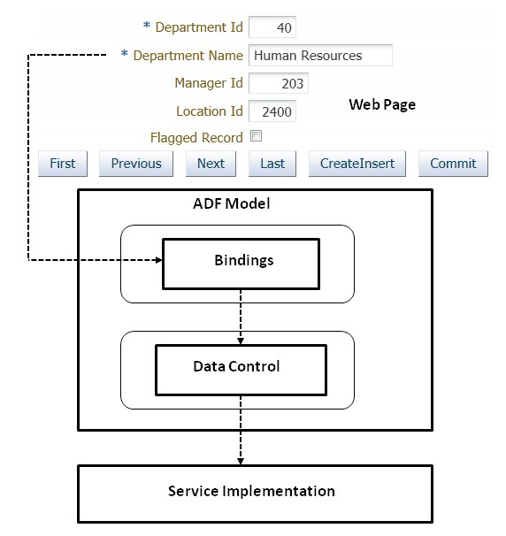
Binding model data with user interfaces
2 - Declarative data binding : Declarative data bindings abstract the details of accessing data from data collections in a data control and the details of invoking its operations.

Slide 6

Building a simple data bound web page
Build a fusion web application workspace
Once you generate an application module along with the desired data model, the same will be exposed in the Data Controls panel
You can use the drag-and-drop offerings from JDeveloper to visually lay out controls on a page.

Slide 7
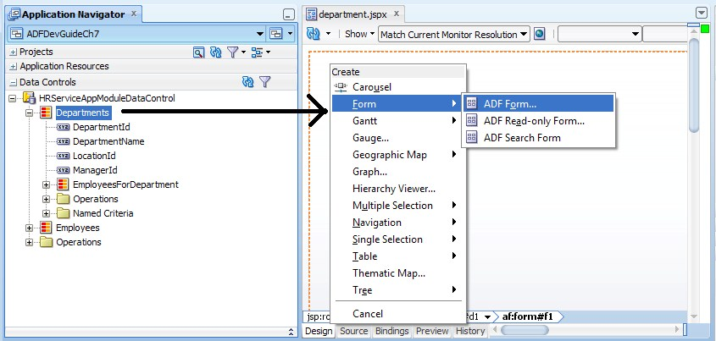
Building a simple data bound web page

Slide 8
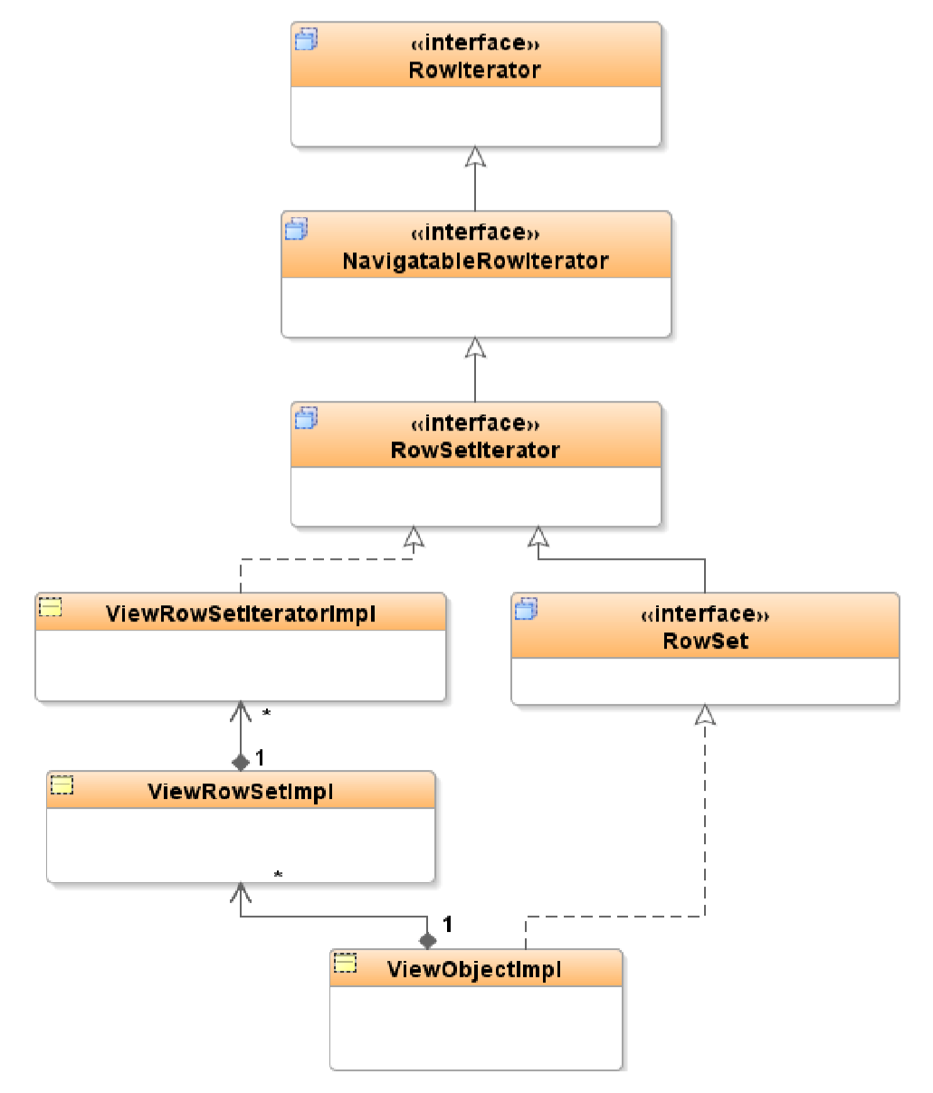
Is a view object really a data collection?
Yes, the view object instance is a data collection (row set) in itself. To understand this point let us take a step back and take a closer look at the structure of the view object.

